Slide 1
Linked Lists

Slide 2
Outline
Singly Linked Lists and Chains
Representing Chains in C
Dynamically Linked Stacks and Queues
Linked List Representation of
Polynomials
Sparse Matrices
Equivalence Classes
Additional Liked List Operations
Liked List Variants
Circular Liked Lists
Doubly Linked Lists

Slide 3
Ordered List: Array Implementation
Task: a ordered list
Add the word “MAT” to the ordered list
? moves
Remove the word “CAT” from the ordered list
? moves
Problems of a sequence representation (array)
Arbitrary insertion and deletion can be very time-consuming
Waste storage
BAT | CAT | EAT | FAT | HAT | JAT | LAT | NAT | OAT | PAT
3

Slide 4
Ordered List: Linked List Implementation
Linked list Implementation
Store the address (location) of the next element in that list.
Each list element is a node
a data component
a pointer to the next item in the list
The pointers are often called links
BAT
VAT
CAT
SAT

Slide 5

Linked List in Memory
first=8

Slide 6
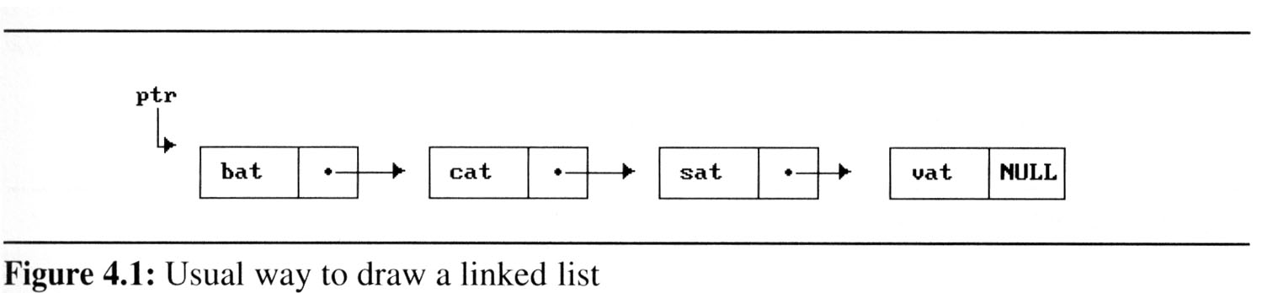
Linked Lists Diagramed
Each link is a node
Data field(s): represented by actual entries
Link/Pointer field(s): represented by arrow(s)
Head pointer points to the first node in the list
ptr points to the first node of the linked list below
ptr is the name of the linked list

Slide 7
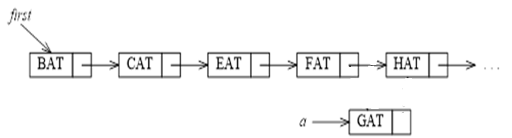

Inserting Nodes
Adding a node (“GAT”)
Get a node that is currently unused; let its address be new_node
Set the data field of this node: “GAT”
Set new_node’s link field: the address of the next node
Set the link field of the previous node to new_node

Slide 8
Deleting Nodes
Delete a node (“GAT”)
find the element that immediately precedes “GAT”: (“FAT”)
set its link field to point to GAT’s link
GAT is no longer in the list (not reachable)

Slide 9
Representing List/Chain in C

Slide 10
Self-Referential Structures
One or more of its components is a pointer to itself.
typedef struct list { char data; list *link; }
list item1, item2, item3; item1.data=‘a’; item2.data=‘b’; item3.data=‘c’;
item1.link=&item2;
item2.link=&item3;
item3.link=NULL;
malloc: obtain a node (memory)
free: release memory
a
b
c

Slide 11
Creating and Releasing Nodes
Declaration
typedef struct list_node *list_pointer;
typedef struct list_node {
char data [4];
list_pointer link;
};
Creation
list_pointer first = NULL;

Slide 12
Creating and Releasing Nodes
Testing
#define IS_EMPTY(first) (!(first))
Allocation
MALLOC(first, sizeof(*first));
Return the spaces:
free(first);

Slide 13
Referencing a Node
NOTE: ptr -> name or (*ptr).name
strcpy(first->data, “BAT”);
first->link = NULL;
address of
first node
first data
first link
•
B A T \0 NULL
first
first->data[0]
first->data[3]

Slide 14
Practice Time
What is the result?
list_pointer create2( )
{
/* create a linked list with two nodes */
list_pointer first, second;
first = (list_pointer) malloc(sizeof(list_node));
second = (list_pointer) malloc(sizeof(list_node));
second -> link = NULL;
second -> data = 20;
first -> data = 10;
first ->link = second;
return first;
}
ptr
first
second
10
•
20
NULL

Slide 15
Inserting a Node
insert a new node, temp, with data = 50 into the list
headed by first at position
following the node pointed to by x
What is the corresponding code?
first
10
20
NULL
x
50
temp

Slide 16
Implementing Insertion (1)
Step 1: Instantiate a new node
void insert (list_pointer *first,
list_pointer x)
{
list_pointer temp;
MALLOC(temp, sizeof(list_node));
temp->data=50;
temp
50

Slide 17
Implementing Insertion (2)
if(*first){ // if nonempty list
temp->link = x->link;
x->link = temp;
}
else{ //if empty list
temp->link = NULL;
*first = temp;
}
}
first
10
20
NULL
x
50
temp

Slide 18
Deleting a Node
first trail x
10
50
20
NULL
first trail x
10
50
20
NULL
first
10
20
NULL

Slide 19
Implementing Deletion
void delete (list_pointer first,
list_pointer trail, list_pointer x)
{ /* delete x from the list, trail is the preceding
node, first is the front of the list, */
if(trail)
trail->link = x->link;
else /* delete first node
first = first->link;
free(x);
}
first x trail=NULL
first trail x
10
50
10
50
20
20
NULL
NULL

Slide 20
Practice Time (Traversing a List)
void print_list(list_pointer ptr)
{
printf(“The list contains: ”);
for ( ; ________; ______________)
printf(“%4d”, ptr->data);
printf(“\n”);
}

Slide 21
Linked List Implementation of Stacks and Queues

Slide 22
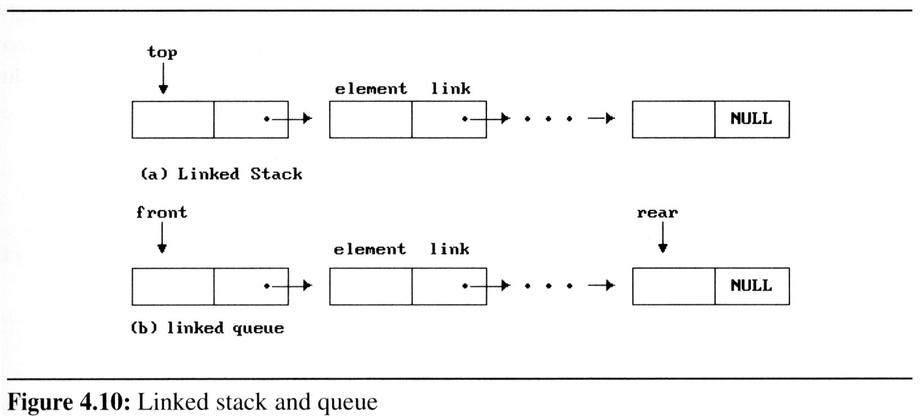
Why Linked Stacks & Queues?
Stack: easy push/pop of a node from the top

Slide 23
Why Linked Stacks & Queues?
Queue: easy addq to the rear and deleteq from the front
Which side is suitable for “rear”?

Slide 24
Representing Stacks
#define MAX_STACKS 10 /* max # of stacks */
typedef struct {
int key;
… /* other fields */
} element;
typedef struct stack *stack_pointer;
typedef struct stack {
element data;
stack_pointer link;
};
stack_pointer top[MAX_STACKS];
Stack
top[i]
data
link
link
...
NULL

Slide 25
Push into the Linked Stack
void push(int i, element item)
{
/* add item to the ith stack */
stackPointer temp;
MALLOC(temp, sizeof (*temp));
temp->data = item;
temp->link = top[i];
top[i] = temp;
}
temp
item
top[i]
...
NULL

Slide 26
Pop from the Linked Stack
element pop (int i)
{
/* remove top element from the ith stack */
stackPointer temp = top[i];
element item;
if (!temp)
return stackEmpty();
item = temp->data;
top[i] = temp->link;
free(temp);
return item;
}
temp
top[i]
data
...
NULL

Slide 27
Representing Queues
#define MAX_QUEUES 10 /* Max # of queues */
typedef struct queue *queue_pointer;
typedef struct queue {
element item;
queue_pointer link;
};
queue_pointer front[MAX_QUEUES],
rear[MAX_QUEUES];
the i^{th} queue
front[i]
data
link
Delete from
link
...
Add to
rear[i]
NULL

Slide 28
enqueue into Linked Queue
void addq (I, item) {
/* add item to the rear of queue I */
queuePointer temp;
MALLOC (temp, sizeof(*temp));
temp->data = item;
temp->link = NULL;
if (front[i])
rear[i]->link = temp;
else
front[i] = temp;
rear[i] = temp;
}
?
front[i]
...
?
rear[i]
NULL
temp
item
NULL

Slide 29
dequeue from Linked Queue
element deleteq (int i) {
/* delete an element from queue I */
queuePointer temp = front[i];
element item;
if (!temp)
return queueEmpty ();
item = temp->data;
front[i] = temp->link;
free (temp);
return item;
}
temp
Item =
front[i]
data
?
?
...
rear[i]
NULL

Slide 30
Summary
Operations with linked stacks and linked queues are both computationally and conceptually simple
No need to shift elements already in stacks or queues to make space for new element
No need to pre-determine the stack/queue size
Insertion can proceed as long as there is memory available

Slide 31
Representing Polynomials using Linked List

Slide 32
Polynomial Definition
In general, we want to represent the polynomial:
a_{i} are nonzero coefficients
e_{i} are nonnegative integer exponents such that
e_{m-1} ＞ e_{m-2} ＞ … ＞ e₁ ＞ e₀ ≧ 0
represent each term as a node
data fields: coefficient and exponent of a term
link field: pointer to the next term
A(x) = a_{m-1}x^{em-1} + . . . + a₀x^{e0}

Slide 33
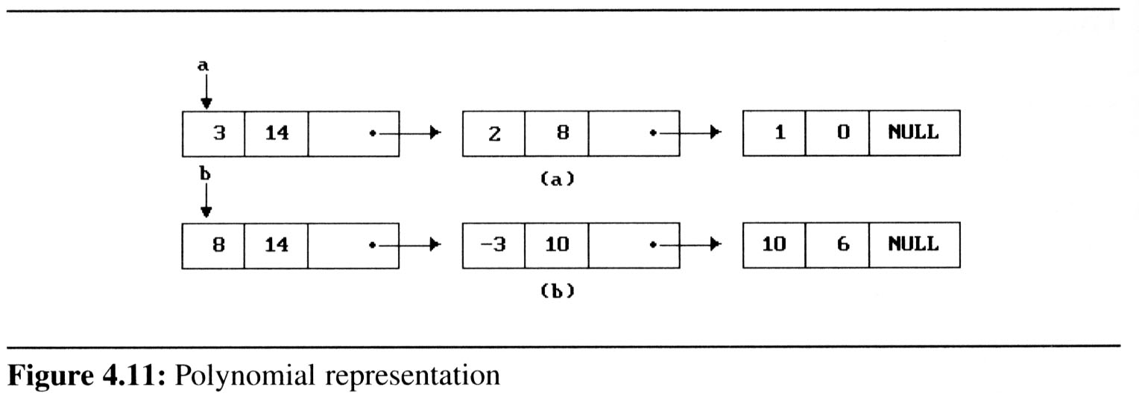
Type Declarations
typedef struct polyNode *polyPointer;
typedef struct polyNode {
int coef;
int expon;
polyPointer link;
};
polyPointer a,b,d;
Each poly_nodes has 3 fields:
a = 3x¹⁴ + 2x⁸ + 1
b = 8x¹⁴ - 3x¹⁰ + 10x⁶
coef | expon | link

Slide 34
Polynomial Access Functions
Example:
e(x) = a(x) * b(x) + d(x)
poly_pointer a, b, d, e;
...
a = read_poly();
b = read_poly();
d = read_poly();
temp = pmult(a, b);
e = padd(temp, d);
print_poly(e);
read_poly()
print_poly()
padd()
psub()
pmult()
perase()

Slide 35
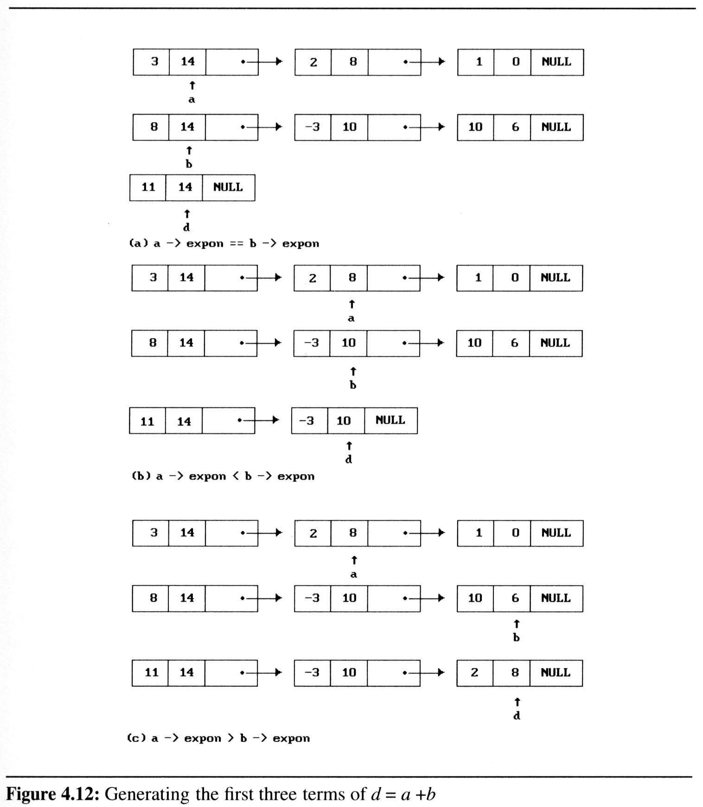
Adding Polynomials (1)
Two terms (nodes) pointed by a and b
If a->expon == b->expon
1. add the two coefficients
2. create a new term for the result
3. advance the pointer to the next term in a and b
a
b

Slide 36
Adding Polynomials (2)
If a->expon < b->expon
1. create a duplicate term of b
2. attach this term to the result, called d
3. advance the pointer to the next term in b
b

Slide 37
Adding Polynomials (3)
If a->expon > b->expon
1. create a duplicate term of a
2. attach this term to the result, called d
3. advance the pointer to the next term in a
a

Slide 38
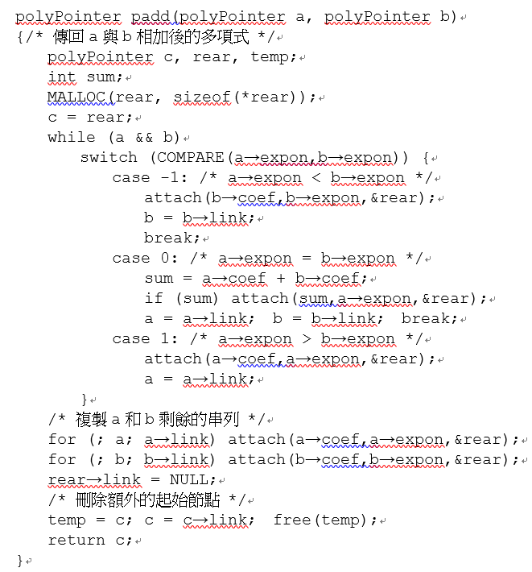
Sample Program
create an empty node initially
remove the empty node

Slide 39
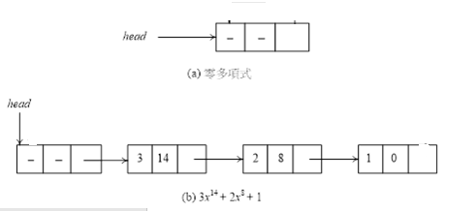
Attaching a New Term
rear

Slide 40
Attaching a New Term
void attach (float coefficient, int exponent,
polyPointer *ptr)
{
polyPointer temp;
MALLOC(temp,sizeof(*temp)); /* create new node */
temp->coef = coefficient; /* assign value
temp->expon = exponent;
temp->link = NULL;
(*ptr)->link = temp; /* attach */
*ptr = temp; /* move ptr to the end of the list */
}
temp
*ptr
*ptr

Slide 41
Practice Time
How to modify the code if ptr is null initially?
void attach (float coefficient, int exponent,
polyPointer *ptr)
{
polyPointer temp;
MALLOC(temp,sizeof(*temp)); /* create new node */
temp->coef = coefficient;
temp->expon = exponent;
temp->link = NULL;
(*ptr)->link = temp; /* attach */
*ptr = temp; /* move ptr to the end of the list */
}

Slide 42
Analysis of padd
A(x) = a_{m-1}x^{em-1} + . . . + a₀x^{e0}
B(x) = b_{n-1}x^{fn-1} + . . . + b₀x^{f0}
coefficient additions ? <= # of additions <= ?
exponent comparisons extreme case: e_{m-1} > f_{n-1} > e_{m-2} > f_{n-2} > … > e₁ > f₁ > e₀ > f₀ ? comparisons
creation of new nodes ? new nodes
summary: O(m+n)

Slide 43
Erasing a Polynomial
Erasing the entire polynomial and free the memory
void perase (polyPointer *ptr)
{
/* erase the polynomial pointed to by ptr */
polyPointer temp;
while (*ptr){
temp = *ptr;
*ptr = (*ptr) -> link;
free (temp);
}
}
?

Slide 44
Variants of Linked List (1)
Circular Linked List

Slide 45
Circular Linked List Representation of Polynomials
Chain
The link field of the last node points to NULL.
Circular Linked list
The link field of the last node points to the first node in the list.
Example
Represent a polynomial ptr = 3x¹⁴+2x⁸+1 as a circular linked list.
ptr
3 | 14
2 | 8
NULL
1 | 0

Slide 46
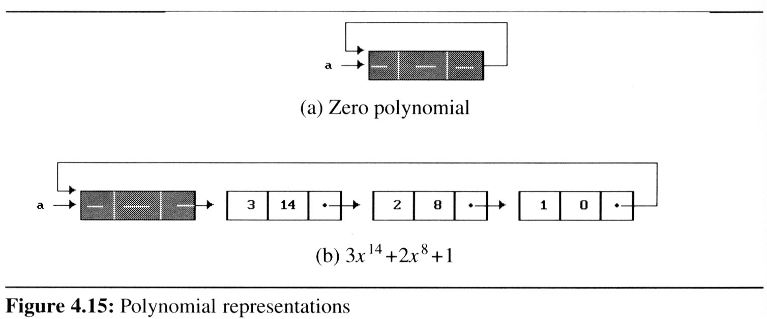
Zero Polynomial
How to represent the zero polynomial?
introduce one additional head node into each polynomial
The expon and coef fields of this node are irrelevant.
A good practice is to set the expon field to -1.
-1
header

Slide 47
Adding Polynomials in Circular Lists
polyPointer cpadd(polyPointer a, polyPointer b)
{/* polynomials a & b are singly linked circular list with a header node.
Return a polynomial which is the sum of a and b */
polyPointer startA, c, lastC;
int sum, done = FALSE;
startA = a; /* record start of a */
a = a->link; /* skip header node for a & b */
b = b->link;
c = getNode (); /* get a header node */
c->expon = -1; lastC = c; /*head node */
do {
. . .
Set the expon field of the head node to -1
lastC will always point to the last node of the c polynomial

Slide 48
cpadd (cont.)
Why is head node->expon set to -1 ?
do {
switch (COMPARE(a->expon, b->expon)) {
case -1: /* a->expon < b->expon */
attach(b->coef, b->expon, &lastC);
b = b->link;
break;
case 0: /* a->expon == b->expon */
if (startA == a) done = TRUE;
else { /* a->expon=-1, so b->expon = -1 */
sum = a->coef + b->coef;
if (sum) attach (sum, a->expon, &lastC);
a = a->link; b = b->link;
}
break;
case 1: /* a->expon > b->expon */
attach (a->coef, a->expon, &lastC);
a = a->link;
}
} while (!done);
lastC->link = c; /*link to the first node */
return c;
}

Slide 49
Inserting at the Front of a CLL
Solution:
Move down to the last node, say last
Insert node after last
x₁
x₂
x₃
last
node

Slide 50
insertFront
x₁
x₂
x₃
last
node
node
last
void insertFront (listPointer *last, listPointer node)
{ if (!(*last)) {
/* list is empty, point last to node */
*last = node;
node->link = node;
}
else {
/* list not empty, add node to front */
node->link = (*last)->link;
(*last)->link = node;
}
}
How to insertLast?

Slide 51
Counting the Length of a CLL
int length (listPointer last)
{ /* find the length of the circular list */
listPointer temp;
int count = 0;
if (last) {
temp = last;
do {
count++;
temp = temp->link;
} while (temp != last);
}
return count;
}
Why need the extra variable temp?
x₁
x₂
x₃
last

Slide 52
Representing Sparse Matrices with Linked Lists

Slide 53
Sparse Matrix Representation
List representation of a sparse matrix
maintain only the nonzero terms
three fields: row, column, and value
represent each row/column as a circular linked list with a header node
ptr
1 | 0 | 4
1 | 3 | 3
Header node
Element nodes

Slide 54
Sparse Matrix Diagramed
2 | 0 | 0 | 0
4 | 0 | 0 | 3
0 | 0 | 0 | 0
8 | 0 | 0 | 1
0 | 0 | 6 | 0
5
4

Slide 55
Sparse Matrix Type Declaration
Link fields in entry nodes:
down field: link to the next non-zero entry in the same column
right field: link to the next non-zero entry in the same row
row | col |  | value
down |  | right
Element node

Slide 56
Sparse Matrix Type Declaration
Link fields in Header nodes:
down field: link into non-zero entries in column i
right field: link into non-zero elements in row i
next field: link to the next header node
Header node
2 | 0 | 0 | 0
4 | 0 | 0 | 3
0 | 0 | 0 | 0
8 | 0 | 0 | 1
0 | 0 | 6 | 0
next
down | right

Slide 57
Sparse Matrix Type Declaration
Link fields in Header nodes:
down field: link into non-zero entries in column i
right field: link into non-zero elements in row i
next field: link to the next header node
next
down | right
Header node

Slide 58
Sparse Matrix Type Declaration
#define MAX_SIZE 50 /* size of largest matrix */
typedef enum {head, entry} tagfield;
typedef struct matrixNode *matrixPointer;
typedef struct entryNode {
int row;
int col;
int value;
};
typedef struct matrixNode {
matrixPointer down;
matrixPointer right;
tagfield tag;
union {
matrixPointer next;
entryNode entry;
} u;
};
matrixPointer hdnode[MAX_SIZES]; /* rows of the matrix */
next
down | right
row | col |  | value
down |  | right

Slide 59
Equivalence Relations

Slide 60
Definition: Equivalence Relation
A relation over a set, S, is said to be an equivalence relation over S iff it is reflexive, symmetric, and transitive over S.
If x, y, z
Reflexive: x ≡ x (e.g., x is equivalent to itself)
Symmetric: if x ≡ y, then y ≡ x.
Transitive: if x ≡ y and y ≡ z, then x ≡ z.

Slide 61
Definition: Equivalence Relation
Examples:
“:=:“ is an equivalence relation over set of integers
12 objects numbered 0 through 11 and
0 :=: 4, 3 :=: 1, 6 :=: 10, 8 :=: 9, 7 :=: 4, 6 :=: 8, 3 :=: 5, 2 :=: 11, 11 :=: 0
there are 3 equivalent classes
{0, 2, 4, 7, 11}, {1, 3, 5}, {6, 8, 9,10}

Slide 62
Practice Time
Let A={0,1,2,3,4} and define a relation R on A×A as follows:
R={(0,0),(0,4),(1,1),(1,3),(2,2),(3,1),(3,3),(4,0),(4,4)}
Find the distinct equivalence classes of RR.

Slide 63
Finding Equivalent Classes
Two Phase Approach
First phase:
read the equivalence pairs (i, j) and organize in a linked list
Second phase:
Begin at 0 and find all pairs of the form (0, j) and (j, 0), then all pair of (j, *) and (*, j), ...
Find another object not yet output, and repeat the above process

Slide 64
Equivalence Relations (2/6)
Phase 1: read in and store the equivalence pairs <i, j>
[0]
11
4
NULL
[1]
3
NULL
[2]
11
NULL
[3]
5
1
NULL
[4]
7
0
NULL
[5]
3
NULL
[6]
8
10
NULL
[7]
4
NULL
[8]
6
9
NULL
[9]
8
NULL
[10]
6
NULL
[11]
0
2
NULL
0 = 4, 3 = 1, 6 = 10, 8 = 9, 7 = 4, 6 = 8, 3 = 5, 2 = 11, 11 = 0

Slide 65
Equivalence Relations (3/6)
Phase 1: read in and store the equivalence pairs <i, j>
[0]
11
4
NULL
Insert x to the top of lists seq[i]
[1]
3
/* Phase 1: Input the equivalence
pairs: */
printf (“Enter . . . :”);
scanf (“%d%d”, &i, &j);
while (i >= 0) {
MALLOC (x, sizeof(*x));
x->data=j; x->link=seq[i]; seq[i]=x;
MALLOC (x, sizeof(*x));
x->data=i; x->link=seq[j]; seq[j]=x;
printf (“Enter . . . :”);
scanf(“%d%d”, &i, &j);
}
NULL
[2]
11
NULL
[3]
5
1
NULL
[4]
7
0
NULL
[5]
3
NULL
[6]
8
10
NULL
[7]
4
NULL
[8]
6
9
NULL
[9]
8
NULL
[10]
6
NULL
[11]
0
2
NULL
Insert x to the top of lists seq[j]
0 = 4, 3 = 1, 6 = 10, 8 = 9, 7 = 4, 6 = 8, 3 = 5, 2 = 11, 11 = 0

Slide 66
Equivalence Relations (4/6)
Phase 2:
begin at 0 and print all j that are equivalent to 0,
i.e.,either <0, j> or <j, 0> from the input
by transitivity, all pairs of the form <j, k> imply that k in the same equivalence class as 0
i.e., either <j, k> or <k, j> from the input
continue this way until marked, and printed the entire equivalent class containing 0
starts a new class with a number not yet printed

Slide 67
Equivalence Relations (5/6)
x
y
[0]
[1]
[2]
[3]
[4]
[5]
[6]
[7]
[8]
[9]
i=
1
0
j=
11
4
7
0
4
0
2
11
[10]
[11]
Phase 2
top
out:
[0]
11
4
NULL
/* Phase 2: output the equivalence classes */
For (i=0; i<n; i++)
if (out[i]) {
printf(“\nNew class: %5d”,i);
out[i] = FALSE; /* set class to false */
x = seq[i]; top = NULL; /* init stack */
for (;;) { /* find rest of class *
while (x) { /* process list */
j = x->data;
if (out[j]) {
printf(“%5d”, j); out[j] = FALSE;
y=x->link; x->link=top; top=x; x=y;
}
else x = x->link;
}
if (!top) break; /* unstack */
x = seq[top->data]; top=top->link;
} }
[1]
3
NULL
[2]
11
NULL
[3]
5
1
NULL
[4]
7
0
NULL
[5]
3
NULL
[6]
8
10
NULL
[7]
4
NULL
[8]
6
9
NULL
[9]
8
NULL
[10]
6
NULL
[11]
0
2
NULL
New class: 0
11
4
7
2

Slide 68
Practice Time
[0]
[1]
[2]
[3]
[4]
[5]
[6]
[7]
[8]
[9]
[10]
[11]
Phase 2
out:
[0]
11
4
NULL
[1]
3
NULL
What is the result of the next output equivalent class?
[2]
11
NULL
[3]
5
1
NULL
[4]
7
0
NULL
[5]
3
NULL
[6]
8
10
NULL
[7]
4
NULL
[8]
6
9
NULL
[9]
8
NULL
[10]
6
NULL
[11]
0
2
NULL

Slide 69
Equivalence Relation (6/6)
Program to find equivalence classes
void main(void){
short int out[MAX_SIZE];
nodePointer seq[MAX_SIZE];
nodePointer x, y, top;
int i, j, n;
printf(“Enter the size (<=%d) ”, MAX_SIZE);
scanf(“%d”, &n);
for(i=0; i<n; i++){
/*initialize seq and out */
out[i] = TRUE; seq[i] = NULL;
}
/* Phase 1 */
/* Phase 2 */
}
#include <stdio.h>
#define MAX_SIZE 24
#define FALSE 0
#define TRUE 1
typedef struct node *nodePointer;
typedef struct node {
int data;
nodePointer link;
};

Slide 70
Additional Linked List Operations
Linked List of Free Nodes

Slide 71
Free Nodes in a Linked List
Free nodes of linked lists can be reused
Free nodes are kept as a linked list of nodes
Efficient algorithm for retrieving, returning, freeing nodes from the linked lists
Instead of using malloc and free
use getNode and retNode
...
avail
List of freed nodes

Slide 72
getNode ( )
avail
...
List of freed nodes
When a new node is needed
Exam the list of free nodes headed by avail
If the list is not empty, then use one of its nodes.
Else MALLOC to create a new node.
polyPointer getNode(void)
{ /* provide a node for use */
polyPointer node;
if (avail) {
node = avail;
avail = avail->link;
}
else
MALLOC (node, sizeof(*node));
return node;
}
How to get a node from avail?

Slide 73
retNode ( )
Returning a node (node) to the list of free nodes
Insert node to the front of the list headed by avail
Initially, we set avail to NULL
Void retNode (polyPointer node)
{ /* return a node to the available list */
node->link = avail;
avail = node;
}
How to insert an unused node to the avail list?
...
node
List of freed nodes
avail

Slide 74
cerase ( ): Erasing an Entire Linked List
Erase a circular list in a fixed amount (constant) of time O(1) independent of the number of nodes in the list
void cerase(poly_pointer *ptr)
{ /* erase the circular list ptr */
poly_pointer temp;
if (*ptr) {
temp = (*ptr)->link;
(*ptr)->link = avail;
avail = temp;
*ptr = NULL;
}
}
ptr
•
•
• • •
•
temp
avail
•
•
• • •
NULL

Slide 75
Additional Linked List Operations
Inverting a Chain

Slide 76
Inverting a Chain
For a list of length ≧1 nodes
the while loop is executed length times
the computing time is linear (O(length)).
...
NULL
lead
invert
×
...
NULL
lead

Slide 77
Invert()
list_pointer invert (listPointer lead)
{ /* invert the list pointed to by lead */
listPointer middle, trail;
middle = NULL;
while (lead) {
trail = middle;
middle = lead;
lead = lead->link;
middle->link = trail;
}
return middle;
}
use two extra pointers
What is the result of the next iteration?
trail
middle
lead
NULL
...
NULL
NULL

Slide 78
Concatenating Two Chains
listPointer concatenate (listPointer prt1,
listPointer ptr2)
{ /* return list ptr1 followed by list ptr2 */
listPointer temp;
/* check for empty lists */
if (!ptr1) return ptr2;
if (!ptr2) return ptr1;
/* neither list is empty, find end of first list */
for (temp = ptr1; temp->link; temp = temp->link);
/* link end of first to start of second */
temp ->link = ptr2;
}
O (length of list ptr1)
temp
NULL
NULL
ptr1
ptr2

Slide 79
Variants of Linked Lists (2)
Doubly Linked Lists

Slide 80
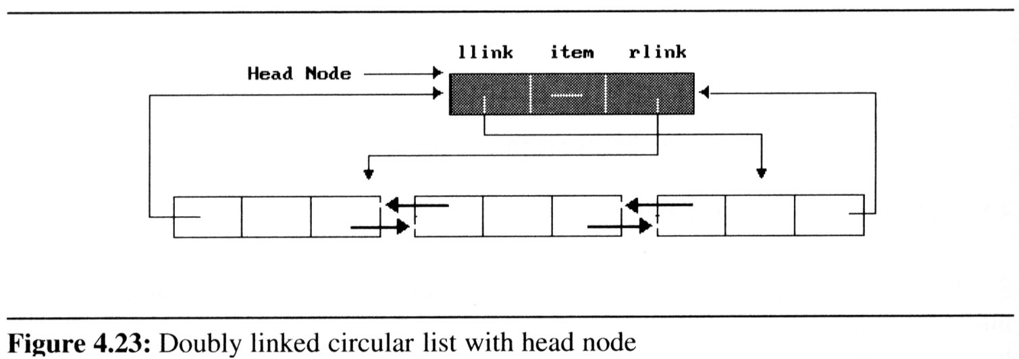
Why Doubly Linked Lists?
Singly linked lists can move only in one direction of the link
Doubly Linked lists can move in two directions
Doubly linked list has at least three fields
left link field(llink), data field(item), right link field(rlink).
The necessary declarations:
typedef struct node *node_pointer;
typedef struct node{
nodePointer llink;
element item;
nodePointer rlink;
};
...
NULL
?
ptr

Slide 81
DLL samples
doubly linked circular list with head node:

Slide 82
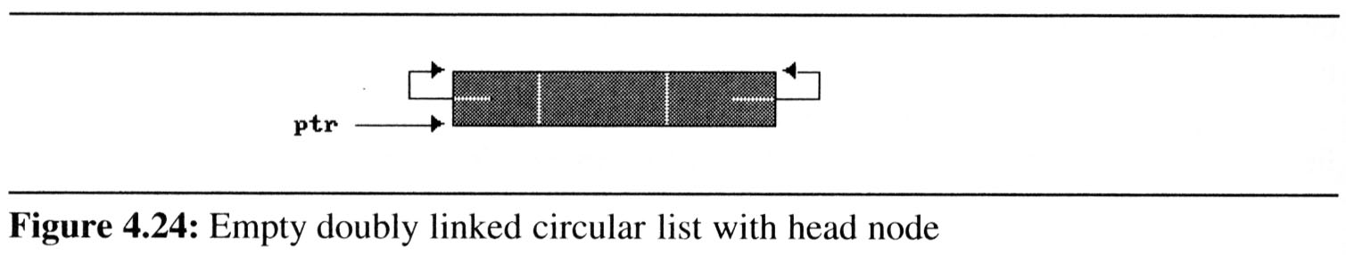
DLL samples
empty double linked circular list with head node
For any node, ptr, in a doubly linked list
ptr == ptr->llink->rlink == ptr->rlink->llink
ptr

Slide 83
Insert a Node to a DLL
void dinsert (nodePointer node, nodePointer newnode)
{ /* insert newnode to the right of node */
newnode->llink = node;
newnode->rlink = node->rlink;
node->rlink->llink = newnode;
node->rlink = newnode;
}
Head node
node
llink item rlink
New node

Slide 84
Deleting a Node from a DLL
void ddelete (nodePointer Hnode, nodePointer deleted)
{
if (Hnode == deleted)
printf (“Deletion of head node not permitted.\n”);
else {
deleted->llink->rlink = deleted->rlink;
deleted->rlink->llink = deleted->llink;
free (deleted);
}
}
Hnode
llink item rlink
deleted

Slide 85
Summary
Singly Linked Lists and Chains
Representing Chains in C
Dynamically Linked Stacks and Queues
Linked List Representation of
Polynomials
Sparse Matrices
Equivalence Classes
Additional Liked List Operations
Liked List Variants
Circular Liked Lists
Doubly Linked Lists

